Slide 1

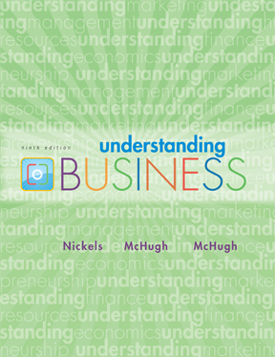
*
Chapter Two
*
Understanding How Economics Affects Business
McGraw-Hill/Irwin
Copyright © 2010 by The McGraw-Hill Companies, Inc. All rights reserved.

Slide 2

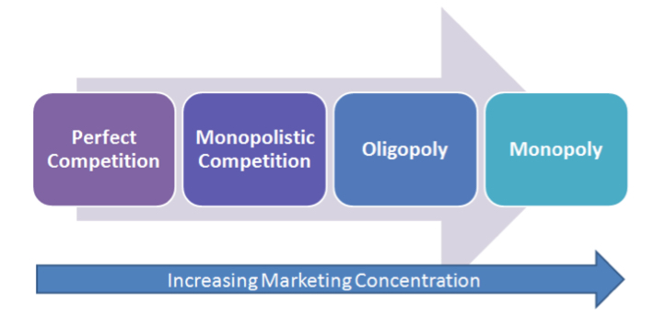
FOUR DEGREES of COMPETITION
Perfect Competition
Monopolistic Competition
Oligopoly
Monopoly

Slide 3
PERFECT COMPETITION
Pure or perfect competition is rare in the real world, but the model is important because it helps analyze industries with characteristics similar to pure competition. This model provides a context in which to apply revenue and cost concepts developed in the previous lecture. Examples of this model are stock market and agricultural industries.
Characteristics
1. Many sellers: there are enough so that a single seller’s decision has no impact on market price.
2. Homogenous or standardized products: each seller’s product is identical to its competitors’.
3. Firms are price takers: individual firms must accept the market price and can exert no influence on price.
4. Free entry and exit: no significant barriers prevent firms from entering or leaving the industry.

Slide 4
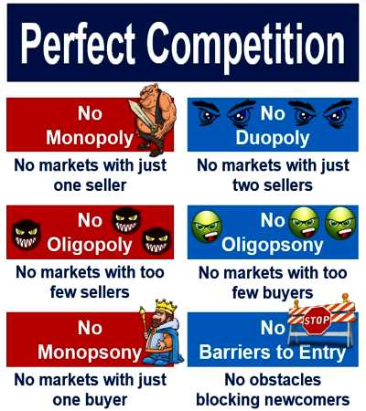

Slide 5
Monopolistic competition
Monopolistic competition refers to a market situation with a relatively large number of sellers offering similar but not identical products. Examples are fast food restaurants and clothing stores.
Characteristics
1. A lot of firms: each has a small percentage of the total market.
2. Differentiated products: variety of the product makes this model different from pure competition model. Product differentiated in style, brand name, location, advertisement, packaging, pricing strategies, etc.
3. Easy entry or exit.

Slide 6
Oligopoly
Oligopoly exits where few large firms producing a homogeneous or differentiated product dominate a market. Examples are automobile and gasoline industries.
Characteristics
1. Few large firms: each must consider its rivals’ reactions in response to its decisions about prices, output, and advertising.
2. Standardized or differentiated products.
3. Entry is hard: economies of scale, huge capital investment may be the barriers to enter.

Slide 7
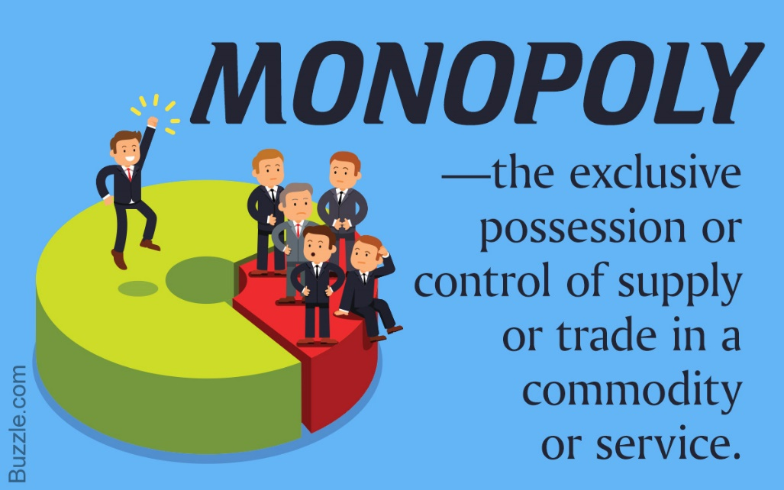
Monopoly
Pure monopoly exists when a single firm is the sole producer of a product for which there are no close substitutes. Examples are public utilities and professional sports leagues.
Characteristics
1. A single seller: the firm and industry are synonymous.
2. Unique product: no close substitutes for the firm’s product.
3. The firm is the price maker: the firm has considerable control over the price because it can control the quantity supplied.
4. Entry or exit is blocked.

Slide 8

Mini Activity/ Individual Class Assessment
Find out 3 organizations for each competitions.

Slide 9
MIXED ECONOMIES
*
The Trend Toward Mixed Economies
LG4
*
Mixed Economies -- Some allocation of resources is made by the market and some by the government.
Neither free-market nor command economies have created sound economic conditions so countries use a mix of the two economic systems.
2-9

Slide 10
TRENDING TOWARD MIXED ECONOMIES
Communist governments are disappearing.
Mostly socialist governments are cutting back on social programs, lowering taxes and moving toward capitalism.
Mostly capitalist countries are increasing social programs and moving toward more socialism.

Slide 11
GROSS DOMESTIC PRODUCT
*
Gross Domestic Product
LG5
*
Gross Domestic Product (GDP) -- Total value of final goods and services produced in a country in a given year. As long as a company is within a country’s border, their numbers go into the country’s GDP (even if they are foreign-owned).
When the GDP changes, businesses feel the effect.
The high U.S. GDP (about $14 trillion) is what enables us to enjoy a high standard of living.
2-11

Slide 12
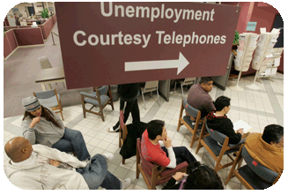
UNEMPLOYMENT
Unemployment Rate -- The percentage of civilians at least 16-years-old who are unemployed and tried to find a job within the prior four weeks.
Four Types of Unemployment
Frictional
Structural
Cyclical
Seasonal

Slide 13
Frictional unemployment refers to those people who have quit work because they didn’t like the job, the boss, or the working conditions and who haven’t yet found a new job. It also refers to those people who are entering the labor force for the first time (e.g., new graduates) or are returning to the labor force after significant time away (e.g., parents who reared children). There will always be some frictional unemployment because it takes some time to find a first job or a new job.
• Structural unemployment refers to unemployment caused by the restructuring of firms or by a mismatch between the skills (or location) of job seekers and the requirements (or location) of available jobs (e.g., coal miners in an area where mines have been closed).
• Cyclical unemployment occurs because of a recession or a similar downturn in the business cycle (the ups and downs of business growth and decline over time). This type of unemployment is the most serious.
• Seasonal unemployment occurs where demand for labor varies over the year, as with the harvesting of crops.

Slide 14
INFLATION
Inflation -- The general rise in the prices of goods and services over time.
Disinflation -- When the price increases are slowing (inflation rate declining).
Deflation -- Prices are declining because too few dollars are chasing too many goods.
Stagflation -- Economy is slowing but prices are going up.

Slide 15
PRODUCTIVITY
*
Productivity in
the United States
LG5
*
Productivity in the service sector grows slowly because of less new technology.
Productivity in the U.S. has risen due to the technological advances that have made production faster and easier.
2-15

Slide 16
BUSINESS CYCLES
*
The Business Cycle
LG5
*
Business Cycles -- Periodic rises and falls that occur in economies over time.
Four Phases of Long-Term Business Cycles:
Economic Boom
Recession – Two or more consecutive quarters of decline in the GDP.
Depression – A severe recession.
Recovery – When the economy stabilizes and starts to grow. This leads to an Economic Boom.
2-16

Slide 17
FISCAL POLICY
*
Stabilizing the Economy Through Fiscal Policy
LG6
*
Fiscal Policy -- The federal government’s efforts to keep the economy stable by increasing or decreasing taxes or government spending.
Tools of Fiscal Policy:
Taxation
Government Spending
2-17

Slide 18
MONETARY POLICY
*
Using Monetary Policy to Keep the Economy Growing
LG6
*
Monetary Policy -- The management of the money supply and interest rates by the Federal Reserve Bank (the Fed).
The Fed’s most visible role is increasing and lowering interest rates.
When the economy is booming, the Fed tends to increase interest rates.
When the economy is in a recession, the Fed tends to decrease the interest rates.
2-18

Slide 19
Individual Class Assessment
Find three innovative companies (local/multinationals) and why do you think they are innovative?

